Slide 1
<!DOCTYPE html>
<html>
<head><title>네이버: 회원가입</title>
<style>
head{
background-color: #f5f6f7;
}
body{
background-color: #f5f6f7;
margin-bottom: 100px;
}
</style>
</head>
<body>
<h1 style="color:#2db400; font-size: 70px; font-family:Arial Black; font-weight: bold; text-align: center">NAVER</h1>
<table border="0" align="center" cellpadding="0" cellspacing="10">
<tr><td><strong>아이디</strong></td></tr>
<tr><td colspan="3" style="; padding:0.6em; border: 1px solid #dadada; background-color: white;"><input type="text" size="53" style="border-style:none; height:30px; font-size:15px;"><span style="color:#8e8e8e;"><small>&nbsp&nbsp&nbsp@naver.com</small></span></td></tr>
<tr></tr>
<tr style="border-color:#f5f6f7;"><td><strong>비밀번호</strong></td></tr>
<tr><td colspan="3" style="; padding:0.6em; border: 1px solid #dadada;background-color: white;"><input type="password" size="68" style="border-style: none; height:30px;font-size:15px;"></td></tr>
<tr></tr>
<tr><td><strong>비밀번호 재확인</strong></td></tr>
<tr><td colspan="3" style="padding:0.6em; border: 1px solid #dadada;background-color: white;"><input type="password" size="68" style="border-style:none; height:30px; font-size:15px;"></td></tr>
<tr></tr>
<tr><td><strong>이름</strong></td></tr>
<tr><td colspan="3" style="padding:0.6em; border: 1px solid #dadada;background-color: white;"><input type="text" size ="68" style="border-style:none; height:30px; font-size:15px;"></td></tr>
<tr></tr>
<tr><td><strong>생년월일</strong></td></tr>
<tr>
<td style="padding:0.6em;border: 1px solid #dadada;background-color: white;"><input type="text" size="15" placeholder="년4자)" style="background-color:white; border-style:none; height:30px; margin-left:7px; font-size:15px;"></td>
<td style="border: 1px solid #dadada;background-color: white;"><form><select name="month" style="width:130px; height:35px; margin-left:10px; border-style:none; font-size:15px;">
<option value="1">월</option>
<option value="2">1</option>
<option value="3">2</option>
<option value="4">3</option>
<option value="5">4</option>
<option value="6">5</option>
<option value="7">6</option>
<option value="8">7</option>
<option value="9">8</option>
<option value="10">9</option>
<option value="11">10</option>
<option value="12">11</option>
<option value="12">12</option></form></td>
<td style="border:1px solid #dadada;background-color: white;"><input type="text" size="15" placeholder="일" style="width:130px; height:30px; margin-left:10px; border-style:none; font-size:15px;"></td>
</tr>
<tr></tr>
<tr><td><strong>성별</strong></td></tr>
<tr><td colspan="3" style="padding:0.6em; border: 1px solid #dadada;background-color: white;"><form>
<select name="sex" style="width:510px; height:30px; border-style:none; font-size:15px;">
<option value="1">성별</option>
<option value="2">남자</option>
<option value ="3">여자</option>
</select>
</form></td></tr>
</tr></tr>
<tr><td><strong>본인 확인 이메일</strong><small style="color:gray">(선택)</small></tr></td>
<tr><td colspan="3" style="padding:0.6em; border:1px solid #dadada;background-color: white;"><input type="text" size="67" style="height:30px;border-style:none; font-size:15px;"></td></tr>
<tr><td><strong>휴대전화</strong></td></tr>
<tr><td colspan="3" style="padding:0.6em; border: 1px solid #dadada;background-color: white;"><form>
<select name="countries" style="width:510px; height:30px;border-style:none; font-size:15px;">
<option value="1">대한민국 +82</option>
<option value="2">네팔 +977</option>
<option value="3">뉴질랜드 +64</option>
<option value="4">스위스 +41</option>
</form></td></tr>
<tr><td colspan="2" style="padding:0.6em; border: 1px solid #dadada;background-color: white;"><input type="text" size="42" placeholder="전화번호 입력" style="height:30px;border-style:none; font-size:15px;"></td>
<td><input type="submit" color:white value="인증번호 받기" style="background-color:#08a600; text-align:center; width:170px; height:55px; font-size:15px; color:white;"></td></tr>
<tr><td colspan="3" style="padding:0.6em; border: 1px solid #dadada; background-color: white;"><input type="text" size="68" placeholder="인증번호 입력하세요" style="height:30px;border-style:none; font-size:15px;"></td></tr>
<tr></tr>
<tr></tr>
<tr><td colspan="3"><input type="submit" value="가입하기" style="background-color:#08a600; text-align:center; width:540px; height:55px; font-size:20px; color:white;"></td></tr></table>
</body>
</head>
</html>

Slide 2
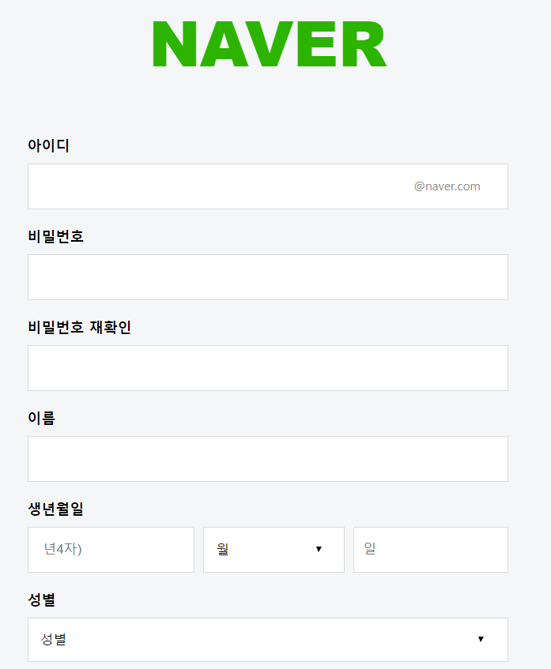
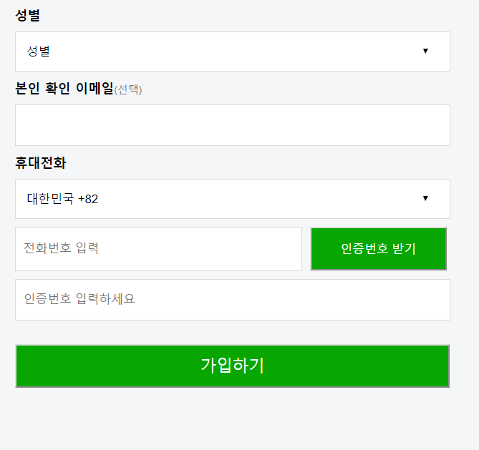

Slide 3
